Slide 1
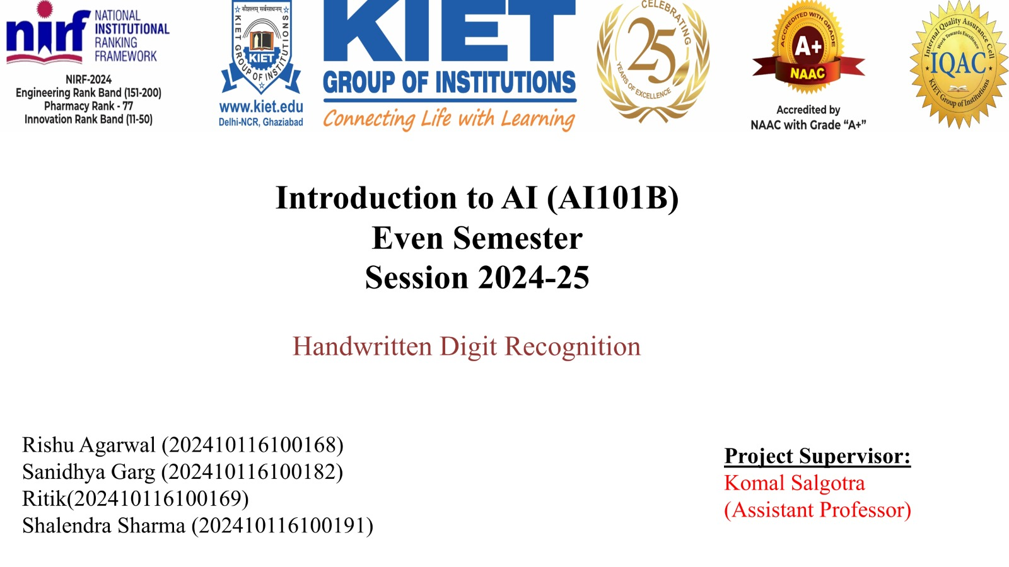

Slide 2
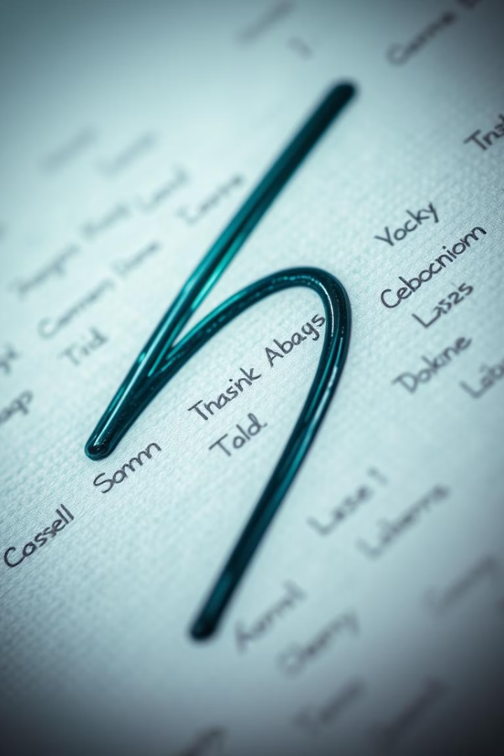
Handwritten Digit Recognition
Explore the world of AI with handwritten digit recognition! This presentation will dive into how machines learn to read our handwriting. From sorting mail to processing checks, discover the technology, techniques, and real-world applications that make it possible.

Slide 3
Defining the Problem
Input
Output
The system receives an image. This image contains a handwritten digit, ranging from 0 to 9.
The goal is for the system to accurately predict. The system must determine the correct digit label.
The main challenges include varied handwriting styles. Overcoming noise and distortions in images is key.

Slide 4
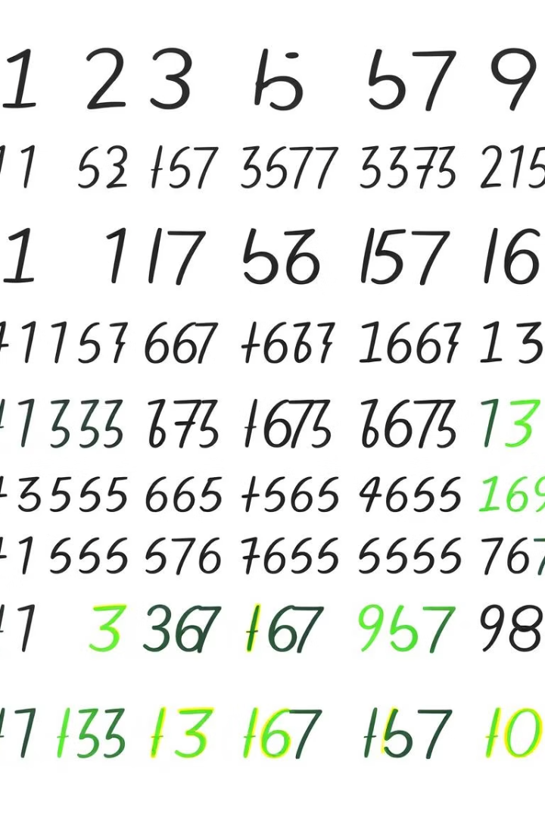
The MNIST Dataset
"Hello World" of Image Classification
Large Collection
It includes 60,000 training images. Also, 10,000 test images.
It's a foundational dataset. Used for image classification tasks.
Image Details
Images are 28x28 pixel grayscale. This provides a simple, standard format.

Slide 5
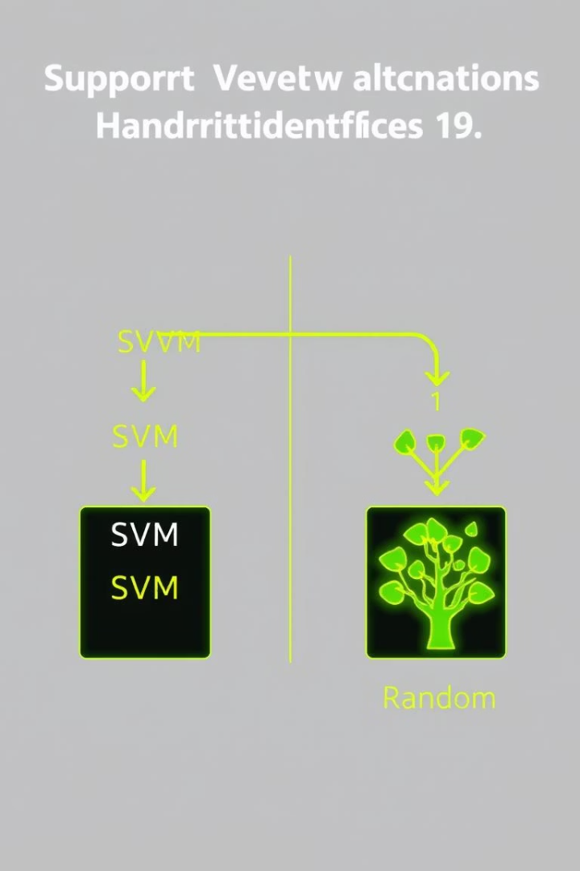


Machine Learning Techniques
SVMs
Random Forests
Achieved ~1.4% error rate on MNIST. Feature engineering enhances effectiveness.
Simpler, faster training than SVMs. Provides accuracy around 3% on MNIST.
Machine learning offers effective methods. These methods solve handwritten digit recognition problems. SVMs use feature engineering to enhance accuracy. Random Forests provide simpler, faster training.

Slide 6

Deep Learning Techniques
Convolutional Neural Networks (CNNs)
LeNet-5 (1998)
An early CNN architecture set the stage.
CNNs provide state-of-the-art performance.
Modern CNNs
Modern CNNs achieve error rates < 1% on MNIST. For example, 99.77% accuracy.

Slide 7
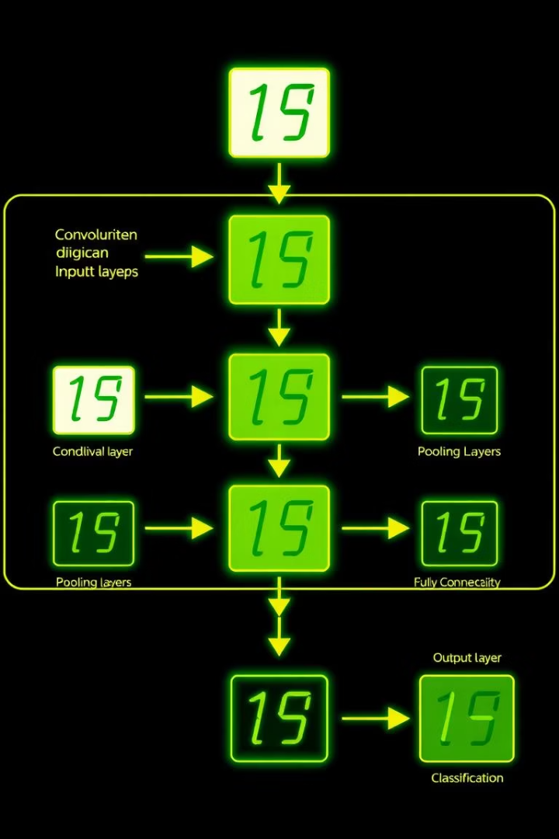




CNN System Architecture
Input Layer
Accepts 28x28 grayscale images.
Convolutional Layers
Extracts important features.
Pooling Layers
Downsamples for efficiency.
Fully Connected Layers
Handles classification tasks.

Slide 8



Real-World Applications
Postal Automation
1
Sorts mail by address and zip code.
Banking
2
Processes checks, enables automated data entry.
Forms Processing
3
Automates data extraction from forms.

Slide 9
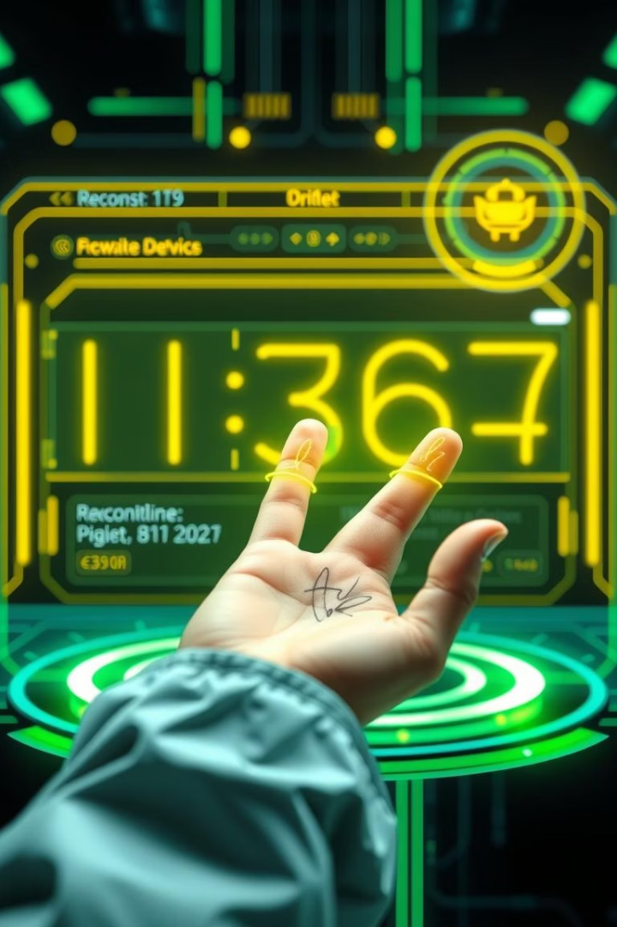
Conclusion
Classic AI Problem
Handwritten digit recognition is a benchmark.
Deep Learning Advances
Achieves near-human performance levels.
Automation Impact
Significant in automation and data processing.

